Slide 1


Building the NGDLE with Tsugi (次) and Koseu (코스)
Dr. Charles Severance
University of Michigan School of Information

Slide 2
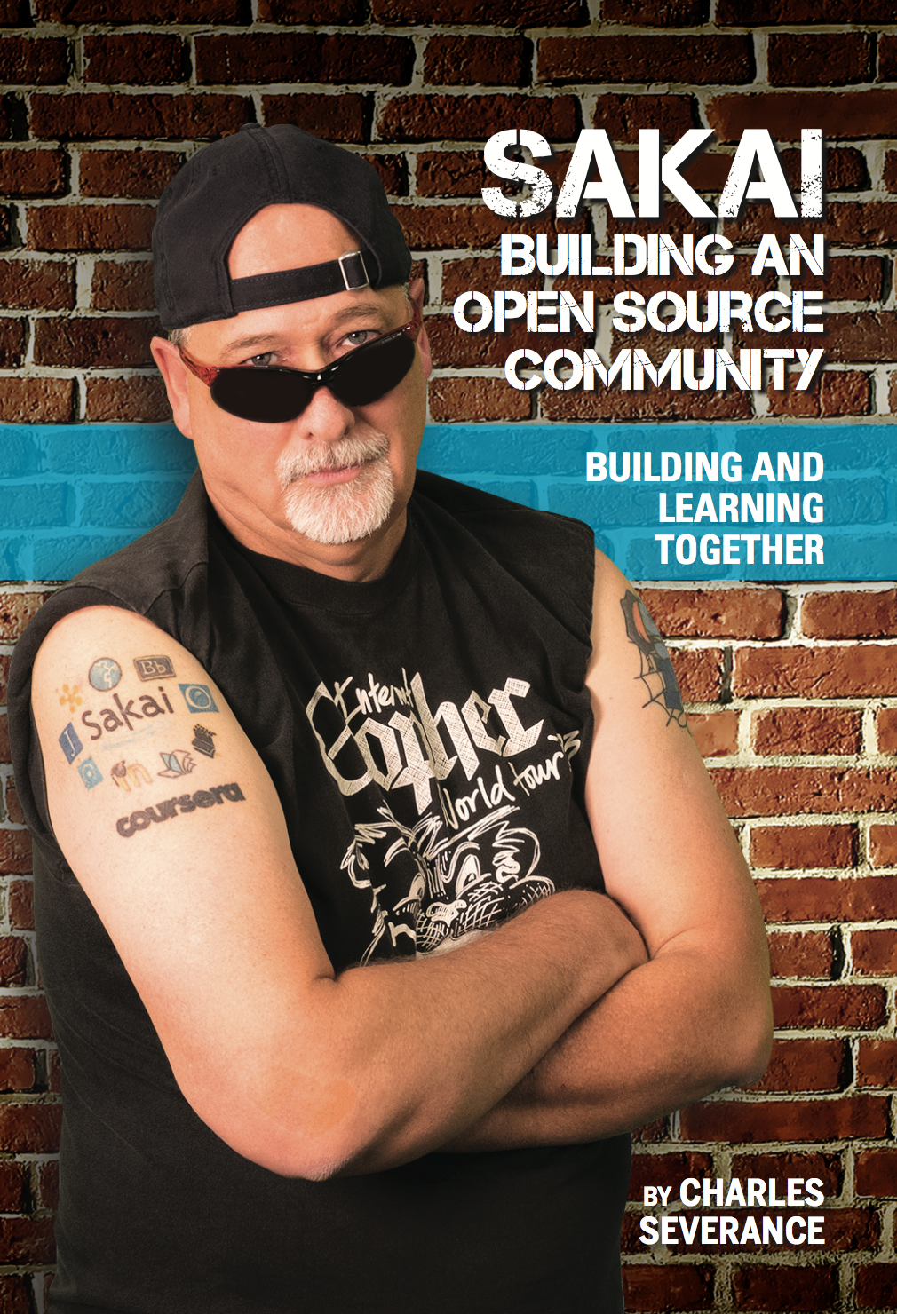
Enterprise Learning Management System (LMS) Been there – done that – got the tattoo.. But…

Slide 3
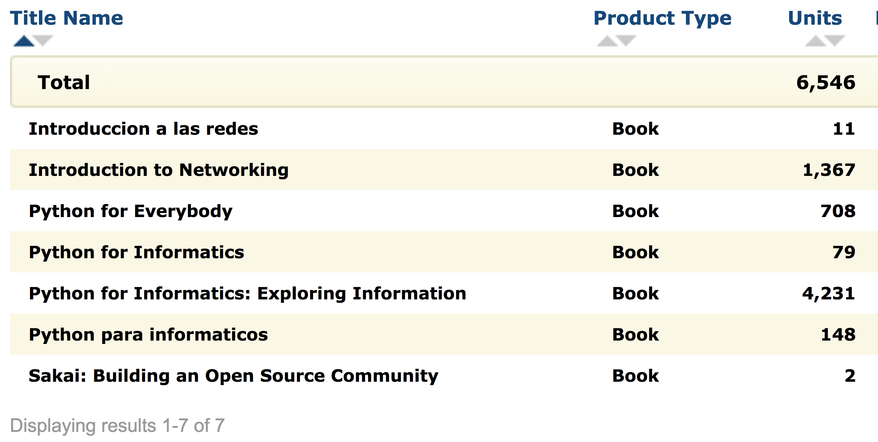

Slide 4

http://planet-fall.deviantart.com/art/The-Monolith-80407794

Slide 5
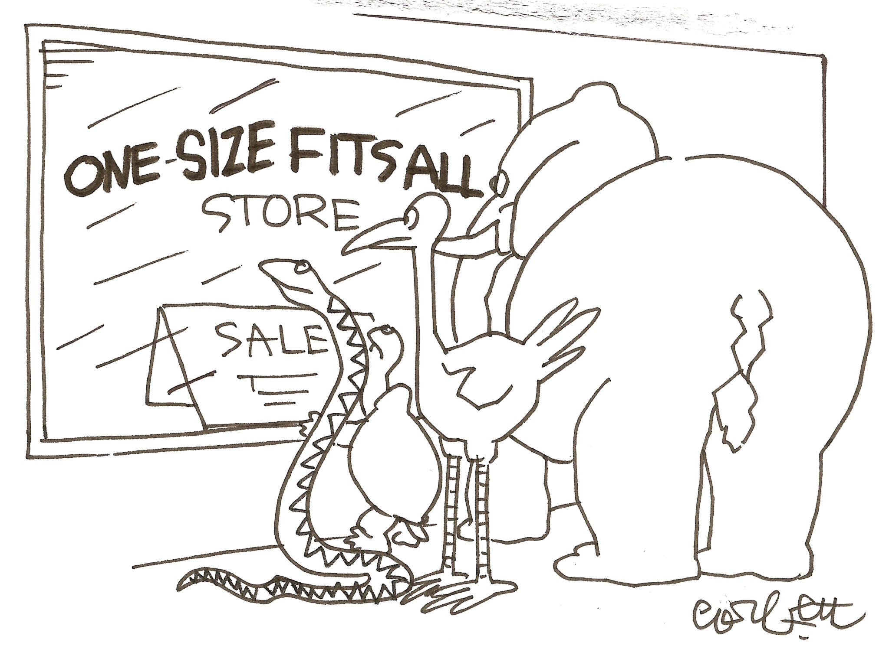

Slide 6
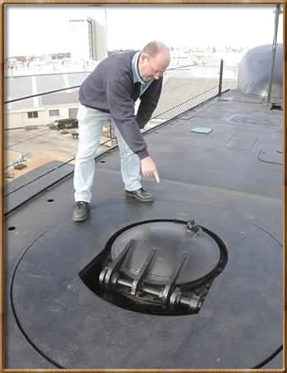

Standards 1.0
IMS Learning Tools Interoperability (LTI) 1.0
17 May 2010
IMS Common Cartridge 1.0
1 October 2008

Slide 7
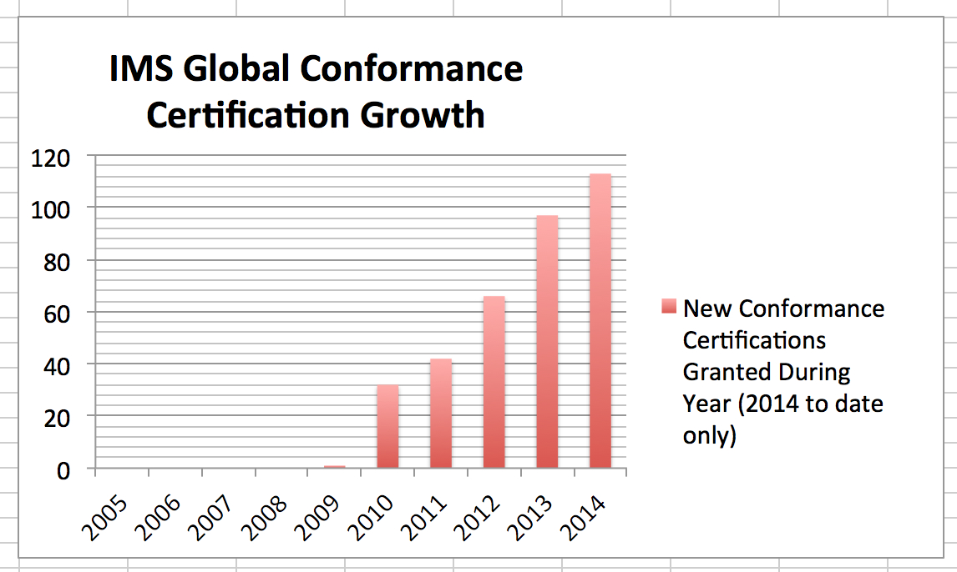
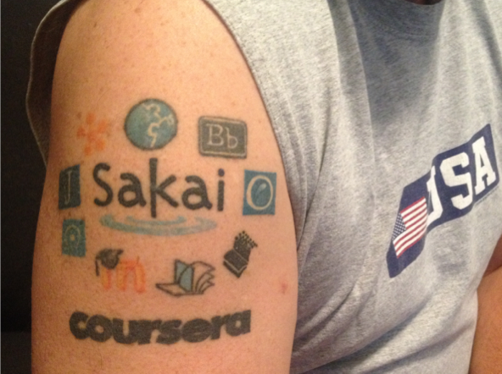

Slide 8


































Slide 9

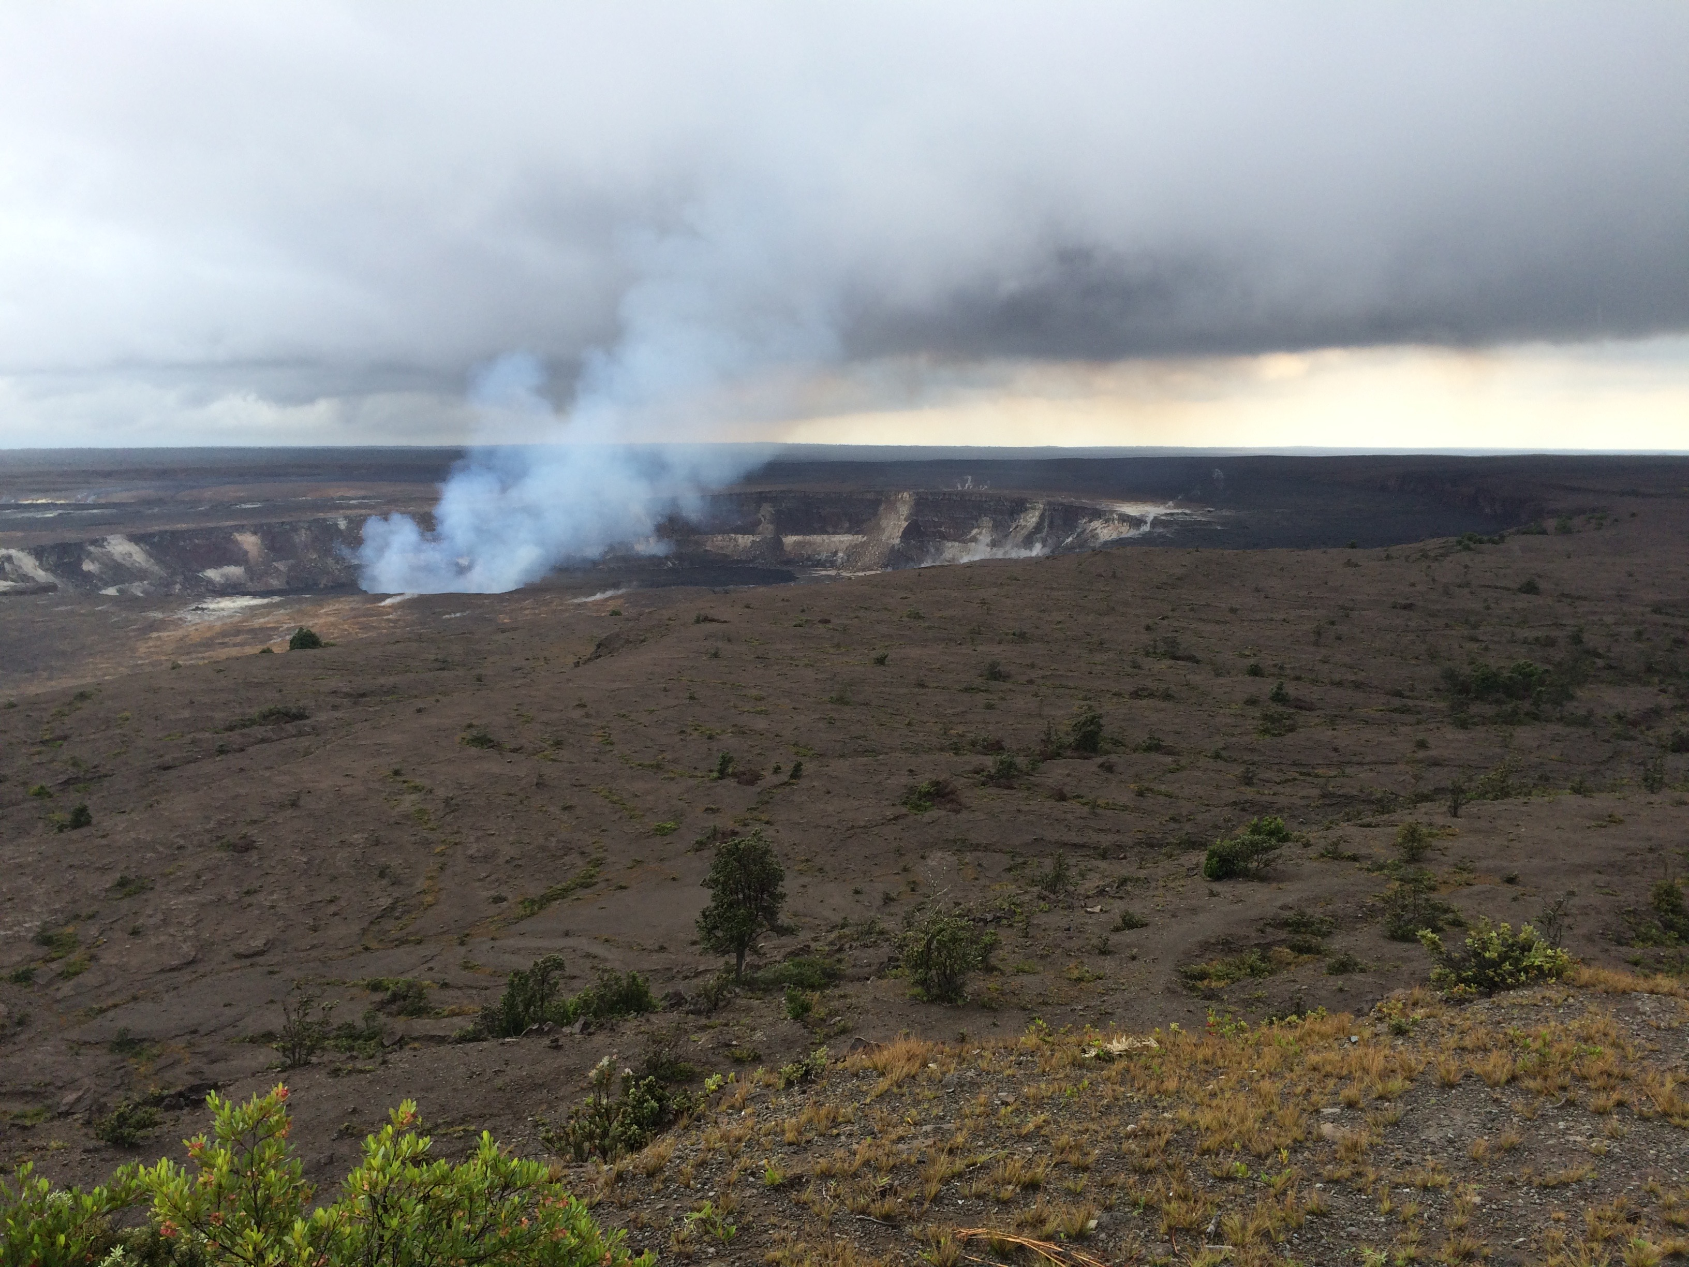
Standards Next Gen
IMS Common Cartridge – 1.0, 1.1, 1.2, 1.3, 2.0
IMS Learning Tools Interoperability 1.0, 1.1, 2.0, 2.1
IMS LTI Content Item - 1.0
IMS LTI Membership Services – 1.0
Outcomes Management Service 2.0
IMS Caliper 1.0, 1.1
IMS OneRoster – 1.0
IMS CC / EPUB 3.0 Coordination

Slide 10

CONTENT ITEM®
CC®
LTI®
IMS CONTENT ITEM® FILLS THE GAPS AND MAKES CONNECTIONS BETWEEN IMS LEARNING TOOLS INTEROPERABILITY® AND IMS COMMON CARTRIDGE®.
LTI®, CC®, and Content Item® are trademarks of IMS Global Learning Consortium, Inc. (www.imsglobal.org)

Slide 11
CONTENT ITEM®
CC®
LTI®
FOR THE FIRST TIME IN THE HISTORY OF EDUCATIONAL TECHNOLOGY, YOU CAN MAKE AN APP STORE OR LEARNING OBJECT REPOSITORY WITHOUT PROPRIETATY EXTENSIONS.
LTI®, CC®, and Content Item® are trademarks of IMS Global Learning Consortium, Inc. (www.imsglobal.org)

Slide 12

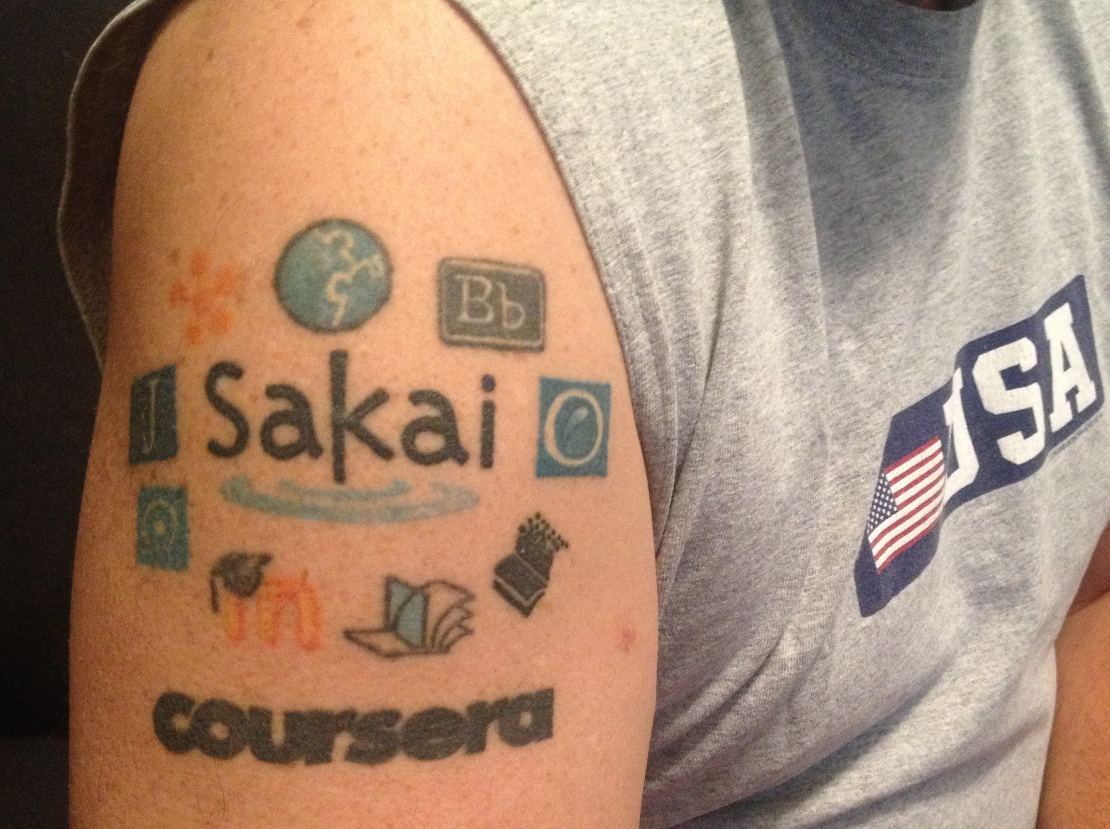
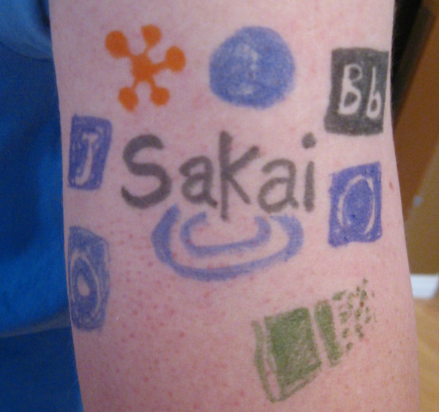
@drchuck
@whitmer
@brackenm

Slide 13
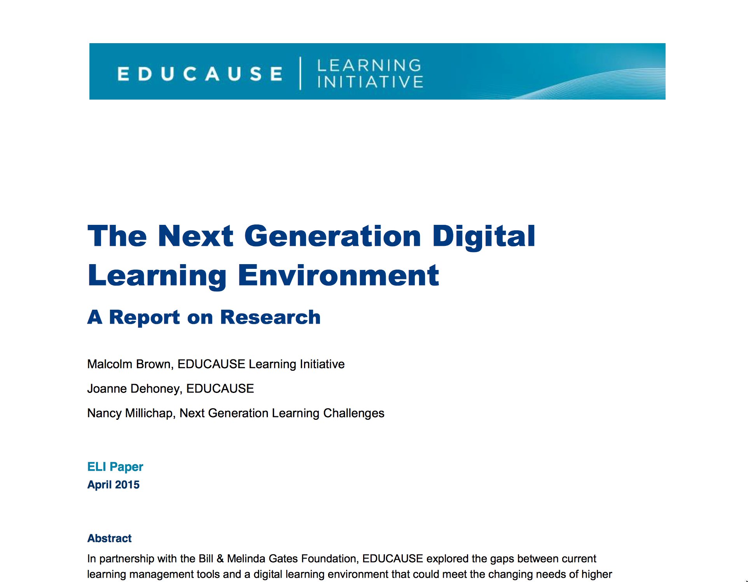
https://net.educause.edu/ir/library/pdf/eli3035.pdf

Slide 14
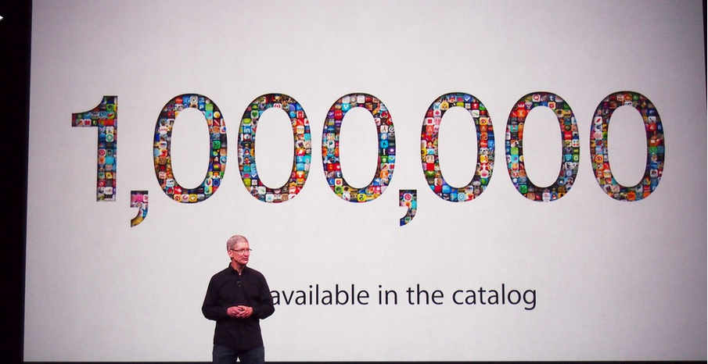
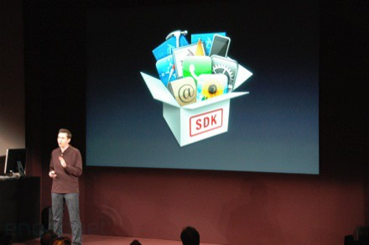
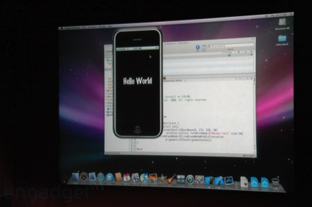
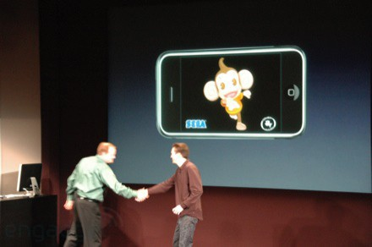
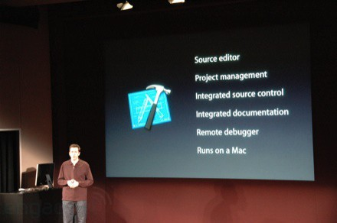
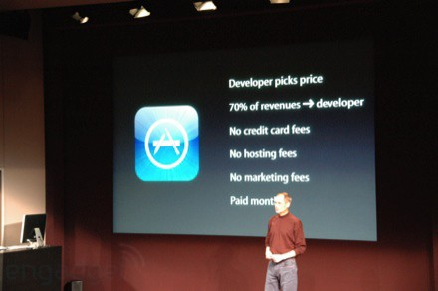
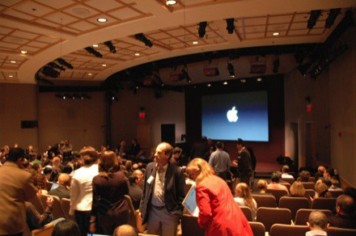
March 6, 2008 iPhone SDK Press Conference

Slide 15

http://planet-fall.deviantart.com/art/The-Monolith-80407794
https://pixabay.com/static/uploads/photo/2014/12/02/22/05/snowflake-554635_960_720.jpg

Slide 16
The Challenge
Need to develop more sophisticated standards for interoperability
Need to train 1000's of developers to read ,understand, and implement the standards
As standards improve they expand and get more complex
Impossible?

Slide 17
We need "WordPress"
A free downloadable off-the-shelf software package that gets people going quickly
Allow thousands of educational sites to be built and put into production by anyone

Slide 18
"EduPress"
An Learning Management System (LMS) of my own
An Open Educational Resource site of my own
A Learning Object Repository (LOR) of my own
A Learning Record Store (LRS) of my own
Millions of sites – millions of courses all similar with common capabilities structure and similar but at the same time unique and distinct

Slide 19
What are 次 and 코스?
Software to allow anyone to build and deploy interoperable educational web sites, content, and learning tools

Slide 20
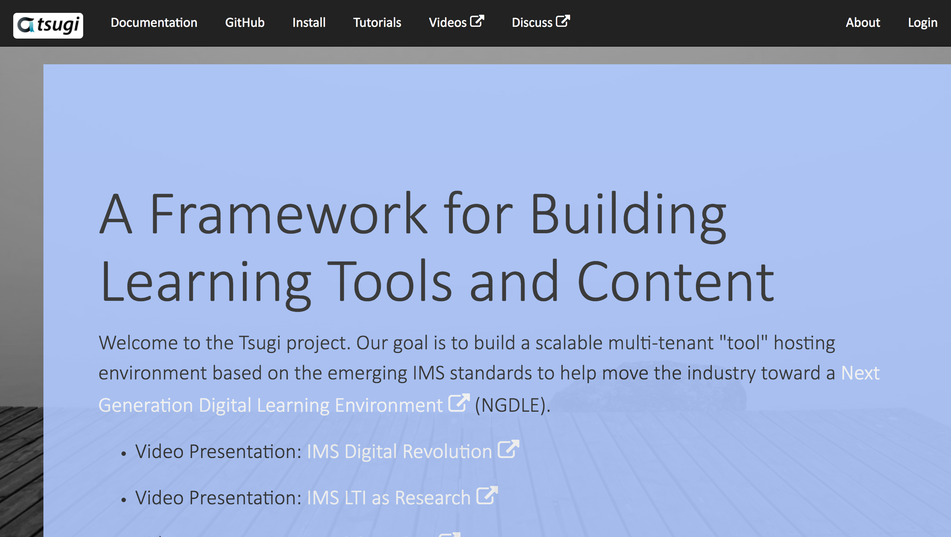
www.tsugi.org

Slide 21
Tsugi (次) is "AppStore" for Ed.
App Store for Learning Applications
API Libraries – PHP, Java, Python, Node...
Open source standards implementations
Hosting / management
Training for Developers (www.tsugi.org)

Slide 22
Koseu (코스) is "EduPress"
Educational web site builder
The world's smallest "LMS"
OER Hosting Site
Standalone MOOC Platform
Standalone Learning Object Repository

Slide 23

CreateSpace
10
Pandoc
py4e.com
App Store (次)
OER Content (코스)
LMS / MOOC
2K
github
1.2M
Coursera
Media
Canvas/Sakai
300
archive.org
Amazon
YouTube
ITunes
GooglePlay

Slide 24
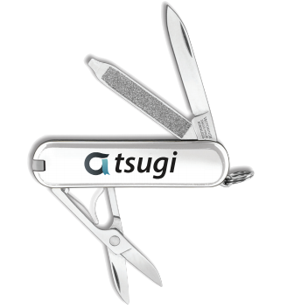
Use Cases
Campus IT Staff – App Store with locally owned data
Instructional Designers – Can focus programmers on building functionality – not reading standards
Faculty – Can build learning content once and use it over and over – content can be open
Book Authors - Can build a site with supporting materials and software with seamless integration into LMSs

Slide 25
Use Cases
OER Publishers – Excellent way to share truly reusable and remixable software and content
MOOC Platform – Small Schools / Single Course / Professional Society
EdTech Startups – A couple of students can have a seamlessly integrated learning tool at MVP in weeks
LMS Vendors – Can encourage their customers to easily build tools that work smoothly rather than break

Slide 26
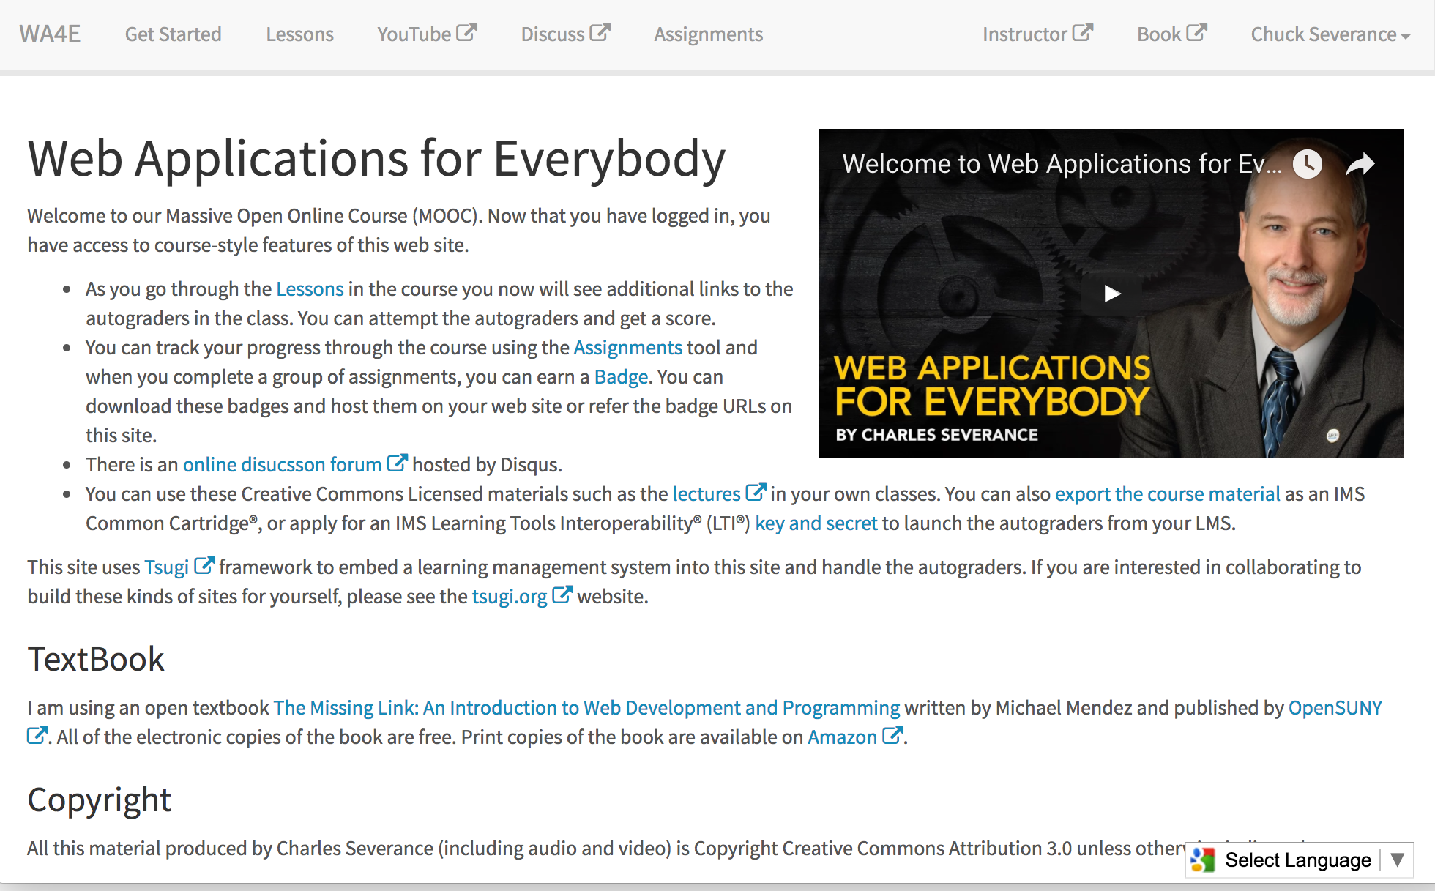
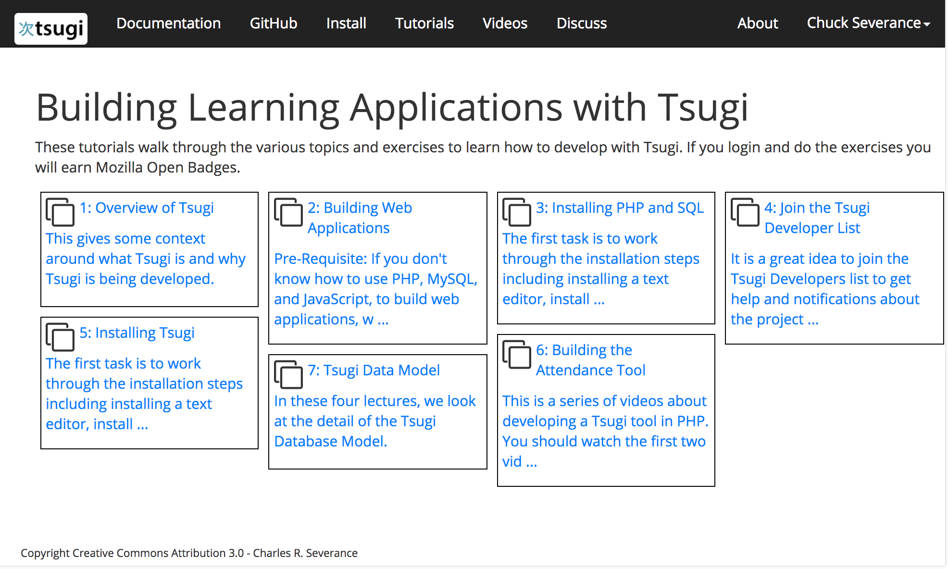
WA4E.com
Developer Training
tsugi.org

Slide 27
Demo (Time Permitting)

Slide 28
Project Status
QA: Unit tests + functionality tests + master in production
My 1.2M Coursera students are doing QA on Tsugi
Production
Coursera + on campus / SchoolCity / OpenOChem
Coordination with OAE Project / LTI 1.0
Interoperability coordination with Canvas, Bb, D2L, Moodle ….
Various levels of Demo/Play
Notre Dame, University of CapeTown, University of Alabama, Wright State.. Who knows…

Slide 29
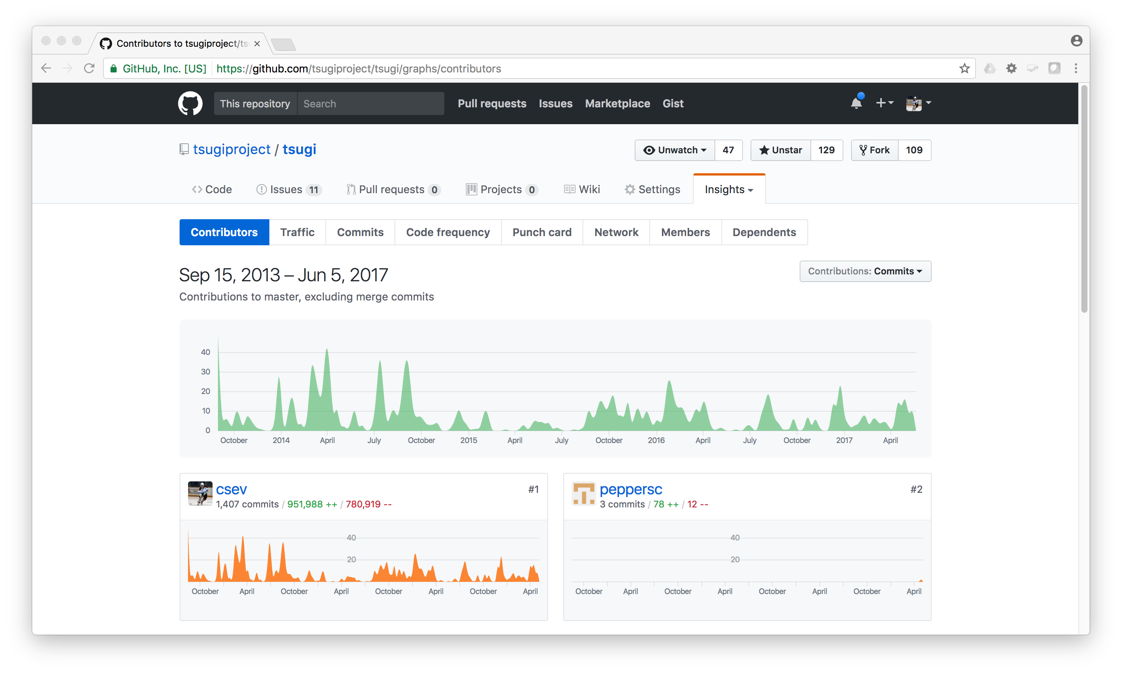

Slide 30
RoadMap
Versions – Master + Stable Branches
0.3.x will be the last pre-separation release
0.4.x will start to truly separate Tsugi and Koseu (week or so)
Learning Registry Coordination – Talking to Gates
Some kind of analytics - XAPI or Caliper
LMSpi – MOOC in box - talking to ADL
Some NDA stuff
Make sure to join the developer list developers.tsugi.org

Slide 31
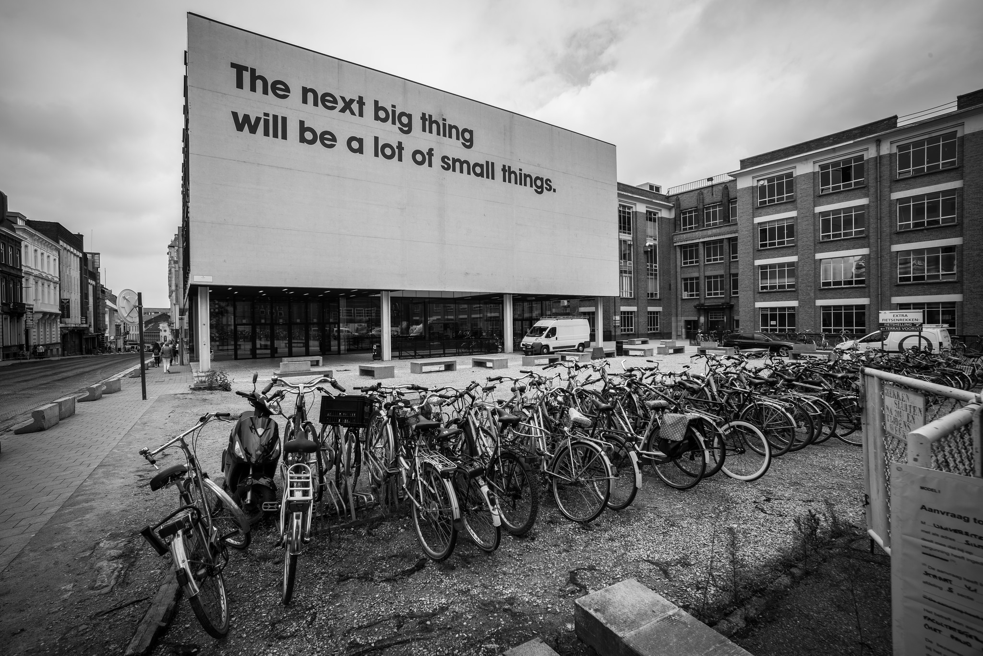
Source: Ian Dolphin

Slide 32
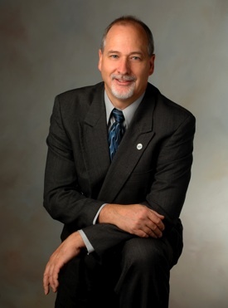
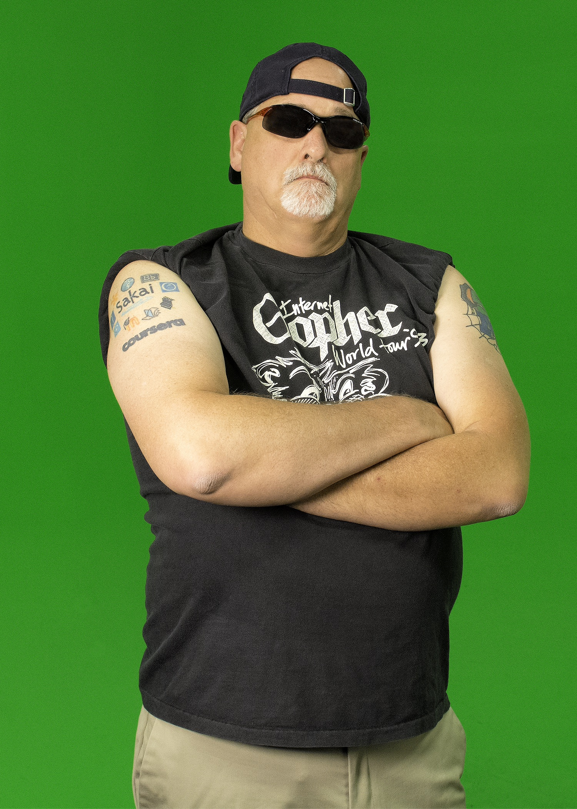

In building the NGDLE, open source will lead the market…

Slide 33

Tsugi is Ongoing Research
Growing, evolving based on experiments (0.3.1)
In incubation as a open source project in the Apereo Foundation (please join and support Apereo)
Participating in IMS Working Groups
Expect 1.0 release early 2018
Need friendly adopters
Need skilled collaborators
Raising funding for grad students, travel, etc
www.tsugi.org

Slide 34
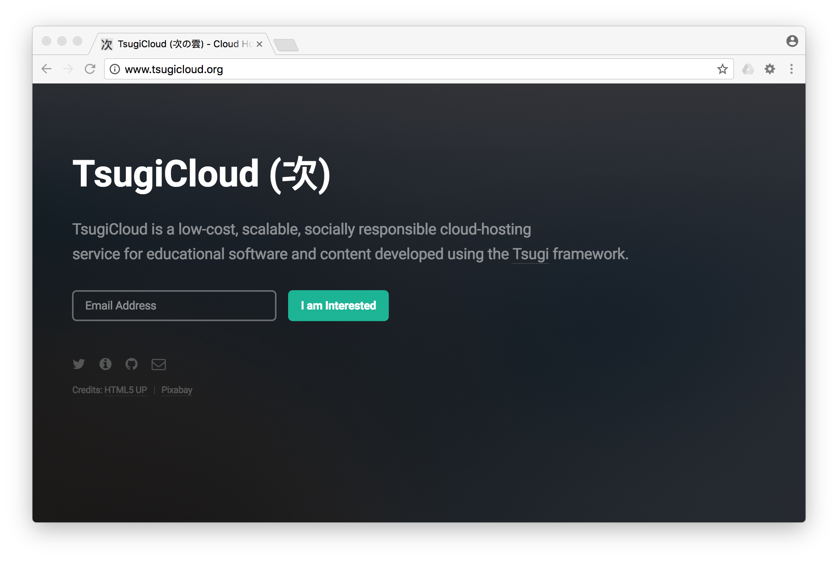

Slide 35
A Few Questions…
Show me how beautiful an LTI Tool's UX can be
Show me the Tsugi Learning Object Repository integrated into Canvas or Sakai
Show me how you use Tsugi to support your Coursera MOOCs
Show me how to set up a Tsugi App Store for my Campus
Show me how easy it is to add a new application to Tsugi
Help me teach a Computer Science Capstone course…
Show me where to start...

